Slide 1
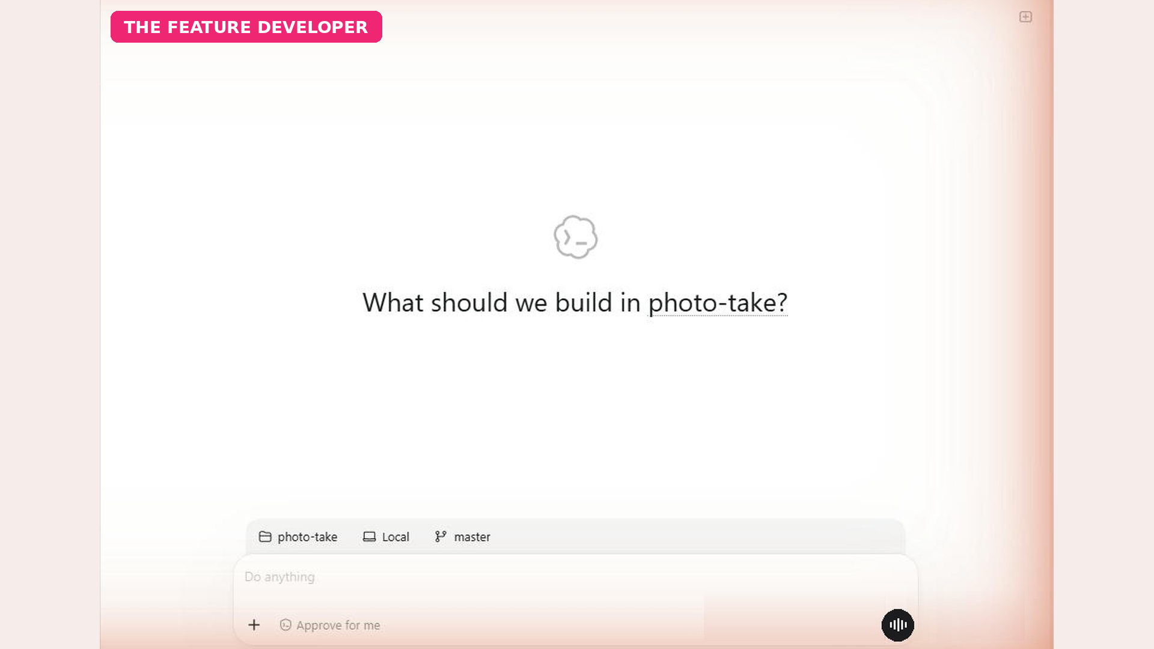
Our project: photo-take
Notes:
Here's a small bookshop app called photo-take. It already has users, a profile page, and a couple of unit tests. It's a typical project you might hand to Codex for a quick feature.

Slide 2

The feature request, in plain English
Notes:
Let's ask Codex for a new feature, in plain English. Let users upload a profile photo, save it under avatars, update the avatar URL, and add tests. That's all the instruction it needs.

Slide 3
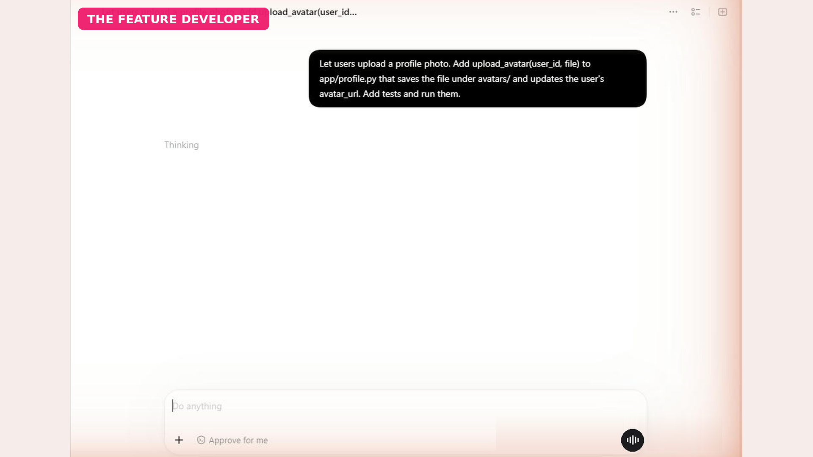
Codex is working (wait shortened)
Notes:
Codex now reads the project, works out where the change belongs, writes the code, and runs the tests on its own. This normally takes a few minutes, so I've shortened the wait here.

Slide 4
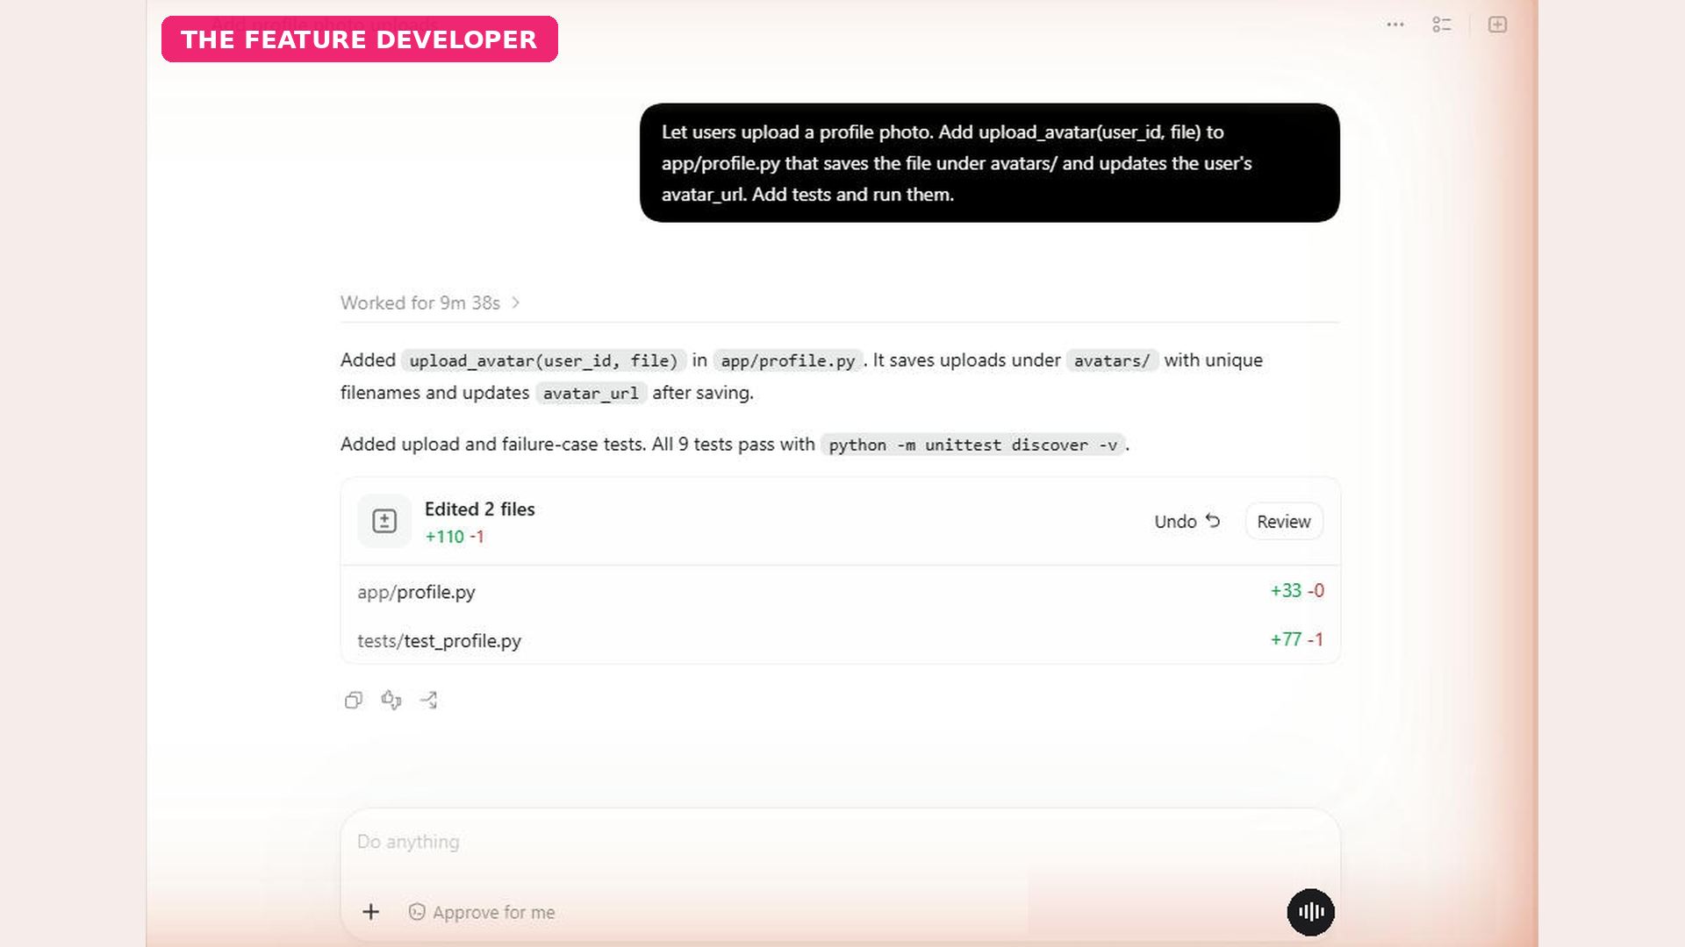
All 9 tests pass
2 files changed
Notes:
And there it is. All nine tests pass, and two files changed. Most of us would ship this right now. But are we ready to commit? Not yet.

Slide 5
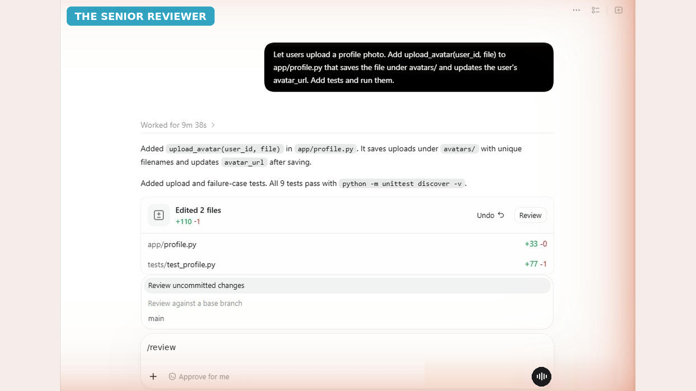
Review uncommitted changes
Notes:
This is where we switch hats, to the Senior Reviewer. I type slash review, and Codex asks what to review. I choose Review uncommitted changes, which is exactly what Codex just wrote.

Slide 6
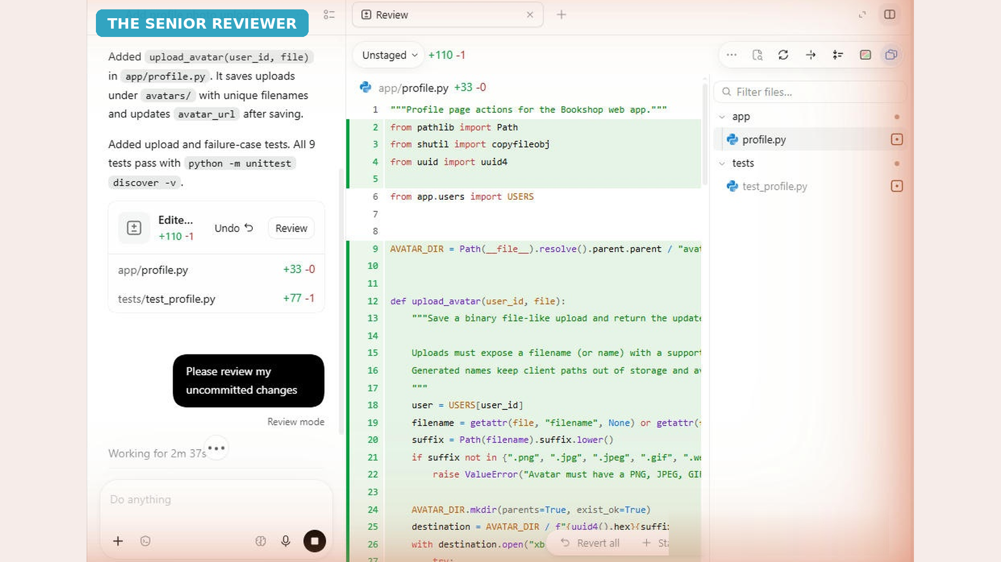
Review mode
Notes:
Codex is now in review mode. It reads the code and looks for real risks, but it doesn't change anything. You stay in control of what gets fixed.

Slide 7
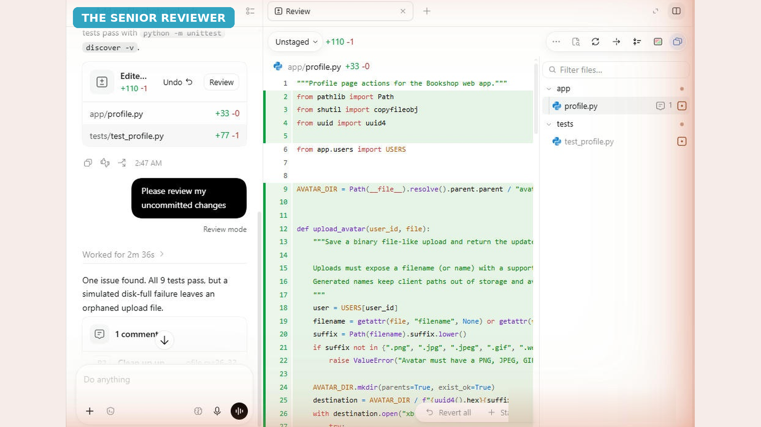
1 issue, tests still green
Notes:
And look what it found. One issue, even though all nine tests are still green. Passing tests only prove the cases someone thought to test.

Slide 8
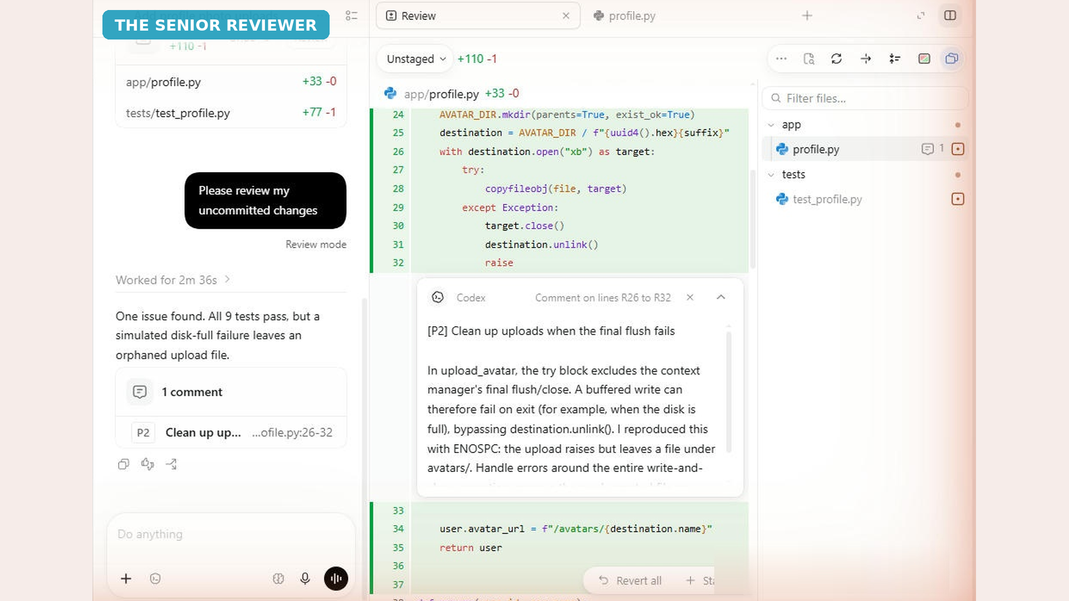
The lines that save the file
P2 finding
Notes:
Here's the comment, right on the lines that save the file. If the disk fills up while a photo is being saved, the upload fails, but a half-saved, broken file stays behind in the avatars folder. Codex even reproduced the failure to confirm it. This is exactly the kind of production problem a good reviewer catches before it ships.

Slide 9
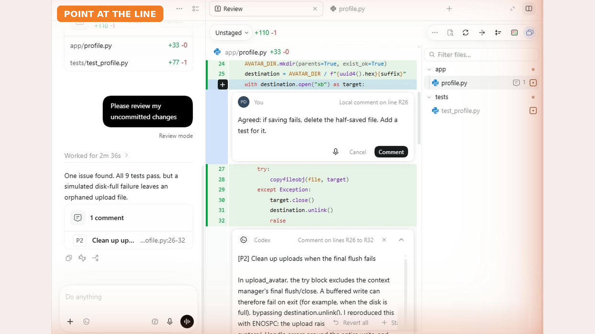
Click +
One-sentence comment
Notes:
I agree with this finding, so I'll point at that exact line. Hover over it, click the plus, and write one clear sentence. If saving fails, delete the half-saved file, and add a test for it.

Slide 10
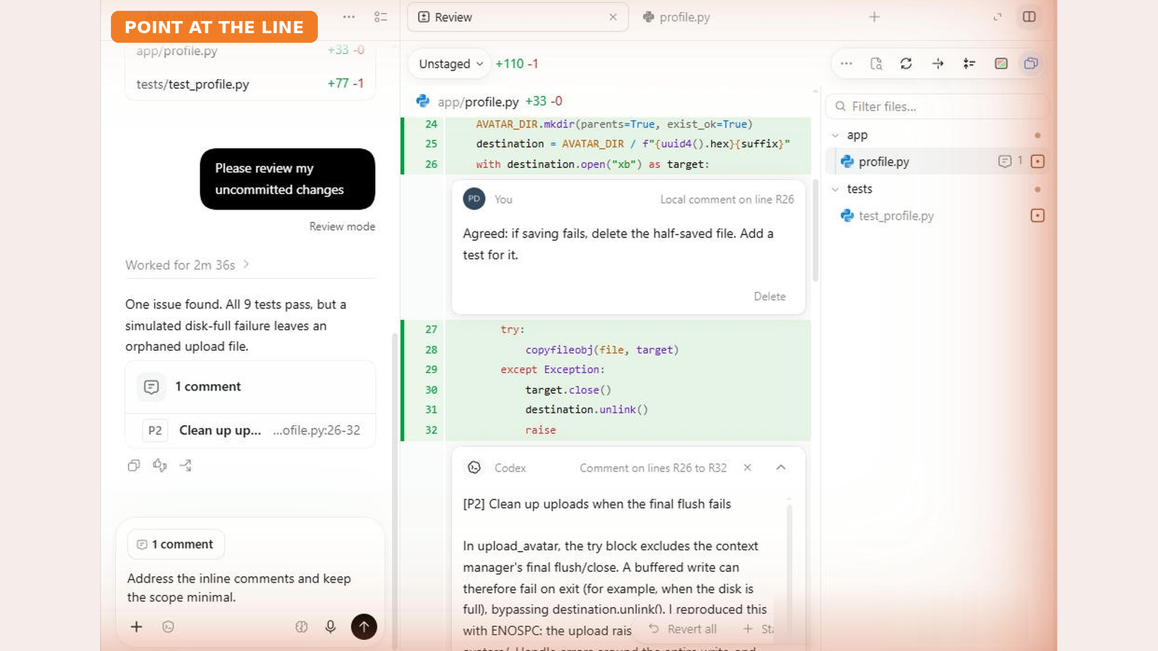
1 comment + minimal scope
Notes:
Then I send one short message. Address the inline comments, and keep the scope minimal. That tells Codex to fix this one problem, and nothing else.

Slide 11
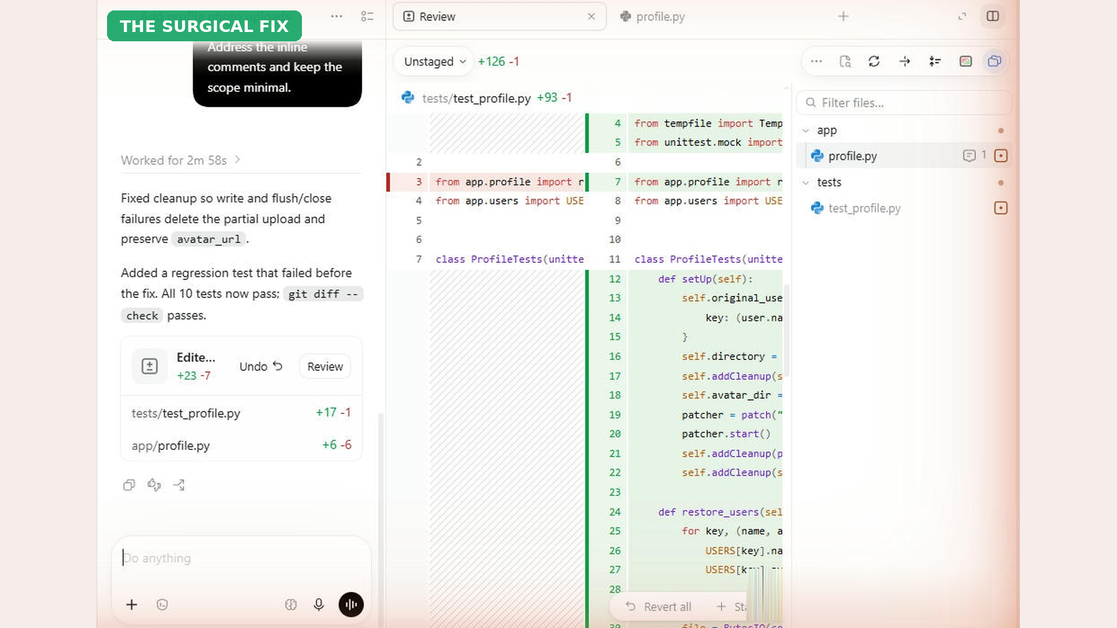
Regression test · 10 pass
Notes:
Codex fixes the cleanup, and adds a new test that failed before the fix. Now all ten tests pass, so we know the bug is really covered.

Slide 12
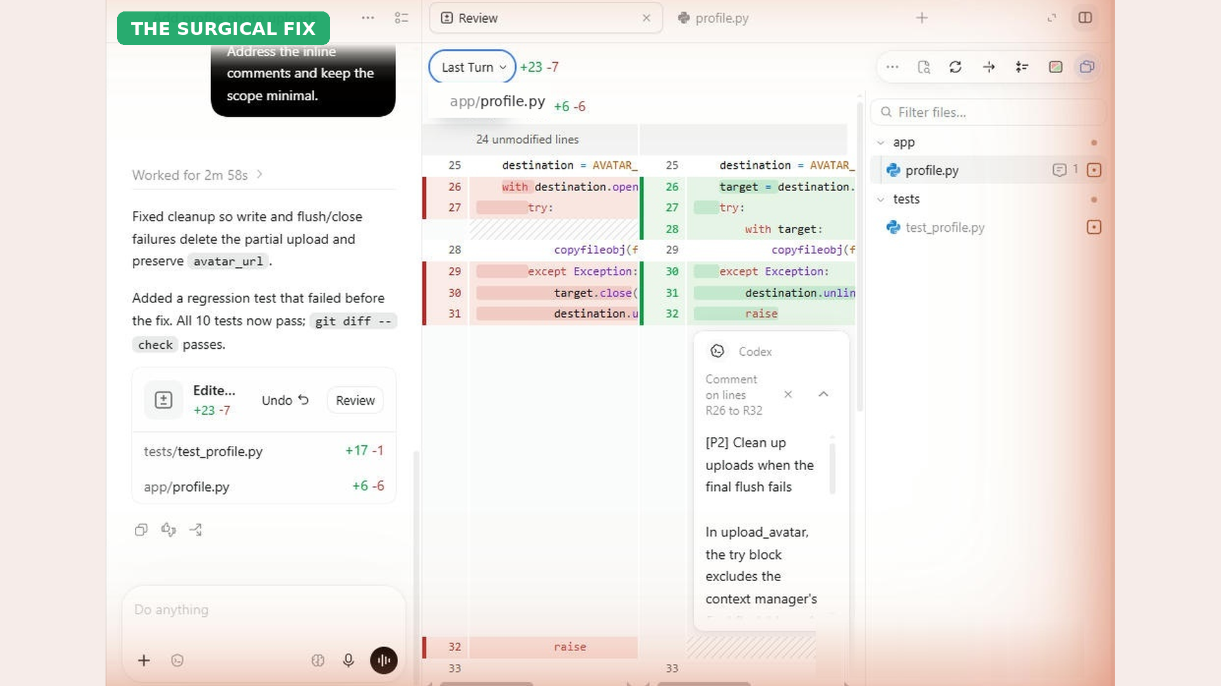
Last Turn
Only the fix: +6 −6
Notes:
Switch the view to Last Turn, and you see only this change. Six lines in, six lines out. No surprise rewrites, and nothing else touched.

Slide 13
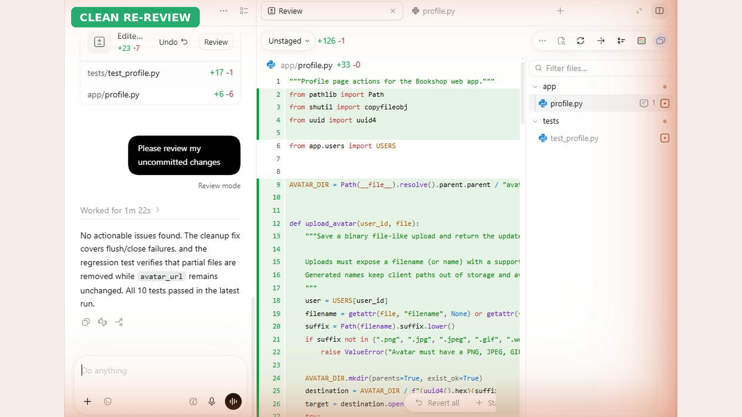
No actionable issues
Notes:
One last check. Slash review again, and this time, no actionable issues. Now, and only now, we're ready to commit. Let's compare the two versions side by side.

